Slide 1
Single Board Computers
Waikato Linux User Group
http://www.wlug.org.nz/
28 March 2016
Ian Stewart

Slide 2
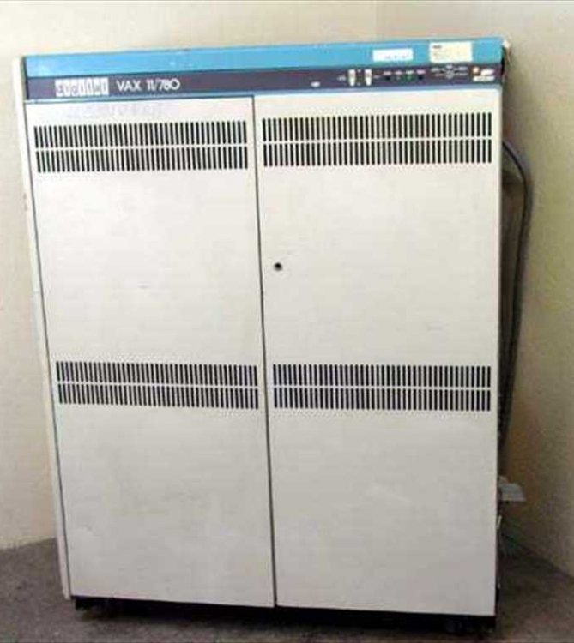
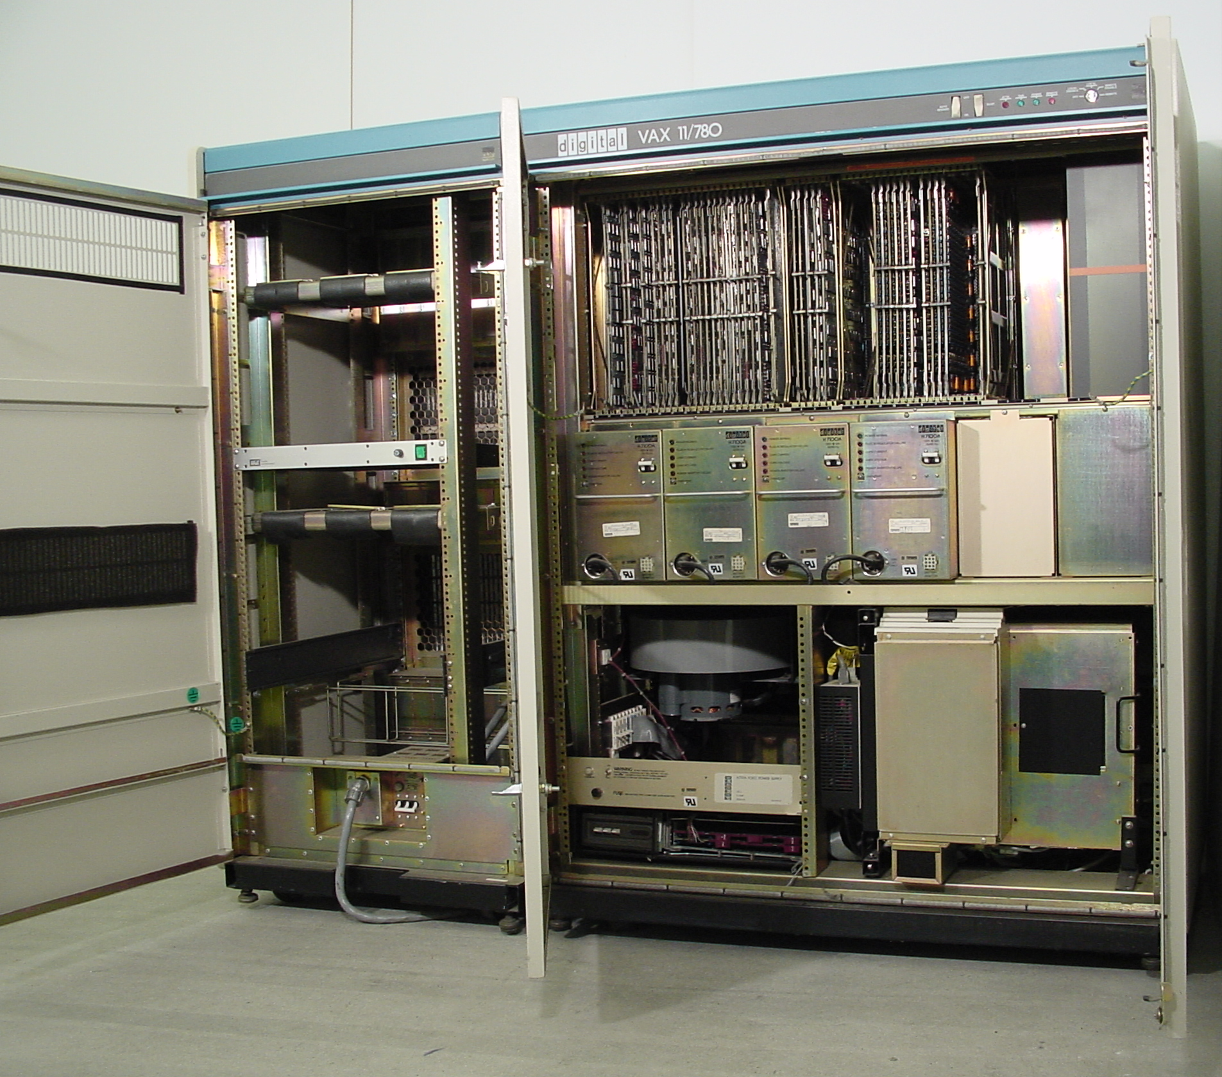
Multi-Board Computers ~ 1977

Slide 3
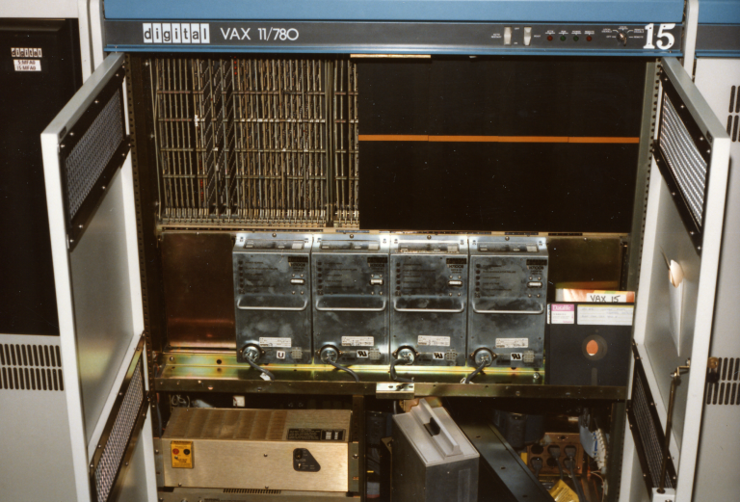
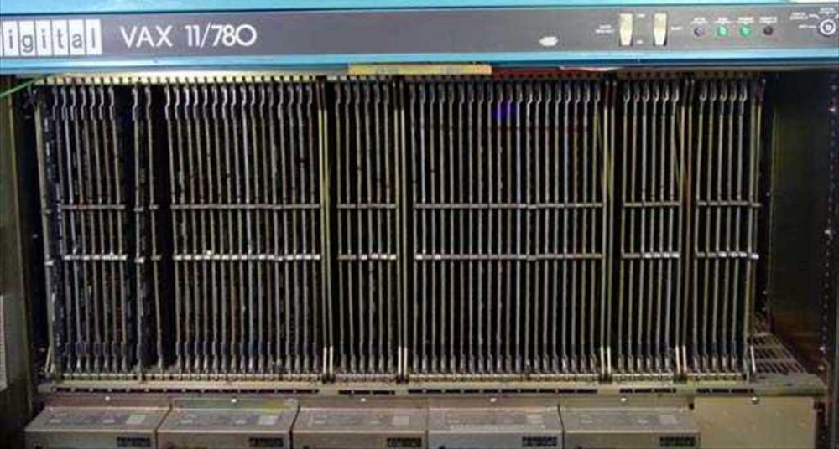
Multi-Board Computers -
TTL devices - 200 ns cycle time (5 MHz) 2 kB cache. 4MB total RAM

Slide 4
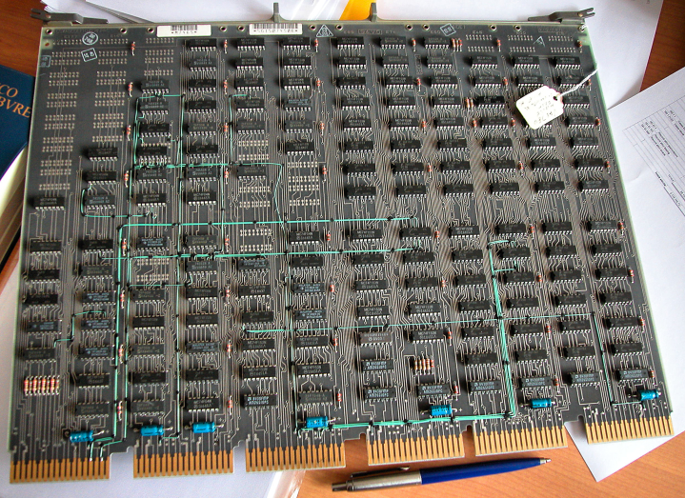
Multi-Board Computers – one of the modules for the CPU

Slide 5
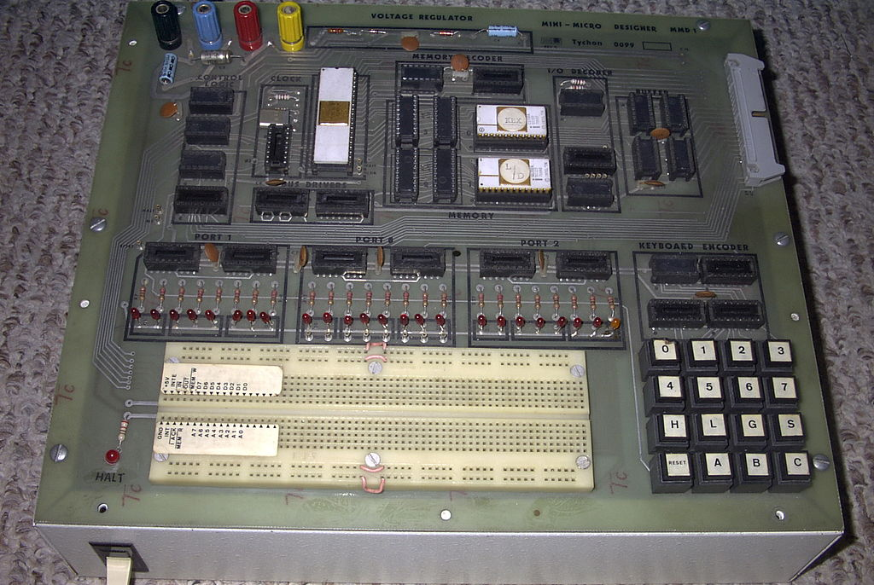
Single Board Computers – 1976
E&L Instruments MMD-1 - Intel C8080A 2.0 MHz

Slide 6
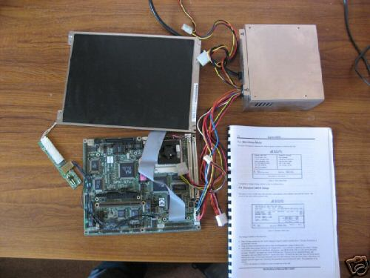
Single Board Computers
Intel 486 33MHz ~ 1990

Slide 7
Single Board Computers ~ since 2010
Arduino Uno
armStoneTMA5
armStoneTMA8
armStoneTMA9
Arndale Board
Banana Pi
Banana Pro
Banana Pi M2
Banana Pi M3
BeagleBoard
BeagleBoard-xM
BeagleBone
BeagleBone Black
C.H.I.P.[69]
Cosmic+ Board
Cubieboard
Cubieboard 2
Cubieboard 3
Cubieboard 4
Cubox-i2
Cubox-i2eX
Cubox-i4Pro
Dragonboard 410c
DreamPlug
Embest SBC8600B
Firefly-RK3288
Foxconn AT-5570
GameStick
Gizmo Board
GoWarrior
Gumstix Overo
Hackberry A10
HiKey
HummingBoard i1
HummingBoard i2
HummingBoard i2eX
Inforce 6410
Inforce 6540]
Inforce 6410plus]
Intel Galileo Gen 2
Intel NUC Board DE3815
Inventami Entry
Inventami Full[30]
MarsBoard A10 New
MarsBoard A20 New
Micro Bit
MicroPython PyBoard
MarsBoard RK3066
MinnowBoard
MIPS Creator CI20
MiraBox
MK802 II
MK808
MTB025
MYIR MYD-AM335X
NanoPC T1
NanoPi 2
Netduino Plus 2
Nitrogen6x
Novena
Nvidia Jetson TK1
Orange Pi
Orange Pi Mini
Orange Pi 2
Orange Pi Mini 2
Orange Pi PC
Orange Pi Plus
Orange Pi Plus 2
Orange Pi One
Orange Pi Lite
ODROID-C1/C1+
ODROID-C2
ODROID-U3
ODROID-W
ODROID-XU

Slide 8
Single Board Computers ~ since 2010
ODROID-XU3
ODROID-XU4
ODROID-XU3 Lite
OLinuXino A10 LIME
OLinuXino A13
OLinuXino A13 MICRO
OLinuXino A13 WIFI
OLinuXino A20 LIME
OLinuXino A20 LIME2
OLinuXino A20 MICRO
Ouya
PandaBoard ES
pcDuino Lite
pcDuino v2
pcDuino3
pcDuino3Nano
PC Engines APU.1C
PC Engines APU.1D4
phyBOARD-Wega
phyBOARD-Mira
PINE A64
PINE A64+
Radxa Rock
Radxa Rock Lite
Raspberry Pi Model A / B rev 1
Raspberry Pi Model B rev 2 / B+
Raspberry Pi 2 Model B
Raspberry Pi 3 Model B
Raspberry Pi Zero
Rikomagic MK802
Rikomagic MK802+ / MK802 II
RIoTboard
RouterBOARD RB450G
RouterBOARD RB953GS-5HnT
Snowball SKY-S9500
Supermicro E100-8Q
TBS 2910 Matrix
Tronsmart Draco Meta
Tronsmart Draco Telos
UDOO Dual Basic
UDOO Dual
UDOO Quad
UP
Utilite Pro
Utilite Standard
Utilite Value
VIA APC 8750 / Rock
VIA EPIA P910
VIA Springboard VAB-600
Wandboard Dual
Wandboard Quad
Wandboard Solo

Slide 9
SBC ~ System on a Chip. SoC
Atmel ATmega328P
ALi M3733-AFAAA
Allwinner A10
Allwinner A13
Allwinner A20
Allwinner A31s
Allwinner A64
Allwinner A80
Allwinner A83T
Allwinner H3
Allwinner R8
AMD C-70 APU
AMD Embedded G-Series T40E APU
Amlogic 8726-MX
Amlogic S805
Amlogic S905
Atmel SAM3X8E
Broadcom BCM2835
Broadcom BCM2836
Broadcom BCM2837
Freescale i.MX6
Freescale i.MX6 Dual
Freescale i.MX6 Dual Lite
Freescale i.MX6 Quad
Freescale i.MX6 Solo
Freescale Vybrid VF6xx
HiSilicon Kirin 620
Ingenic JZ4780
Intel Atom E3815
Intel Atom E640
Intel Quark SoC X1000
Intel x5-Z8350
Intel® Quark™ SoC X1021
Marvell Armada 370
Marvell Kirkwood 88F6281
Nordic Semiconductor nRF51822
Nvidia Tegra 3 T33-P-A3
Nvidia Tegra K1
Qualcomm Atheros AR7161
Qualcomm Atheros QCA9558
Qualcomm Snapdragon 410
Qualcomm Snapdragon 600 (APQ8064M)
Qualcomm Snapdragon 805 (APQ8084)
Rockchip RK3066
Rockchip RK3188
Rockchip RK3288
Samsung Exynos 4 (4412)
Samsung Exynos 4 Quad
Samsung Exynos 5
Samsung Exynos 5 Octa (5410)

Slide 10
SBC ~ System on a Chip. SoC
Samsung Exynos 5 Octa (5422)
Samsung S5P4418
Samsung S5PV210
STM32F405RG microcontroller
STMicro STM32 F4
TI OMAP3530
TI OMAP4460
TI Sitara AM3359
TI Sitara AM335x
TI Sitara AM3703
TI Sitara AM37x
VIA Nano QuadCore L4650E
WonderMedia WM8750
WonderMedia WM8850
WonderMedia WM8950

Slide 11
SBC ~ Architecture
AVR
ARM Cortex M4 CPU
ARM Cortex-A12
ARM Cortex-A15
ARM Cortex-A15x4
ARM Cortex-A15x4/ARM Cortex-A7x4
ARM Cortex-A5
ARM Cortex-A53
ARM Cortex-A7
ARM Cortex-A8
ARM Cortex-A9
ARM Cortex-M0
ARM Cortex-M3
ARM Cortex-M4
ARM-Cortex-A7
ARM11
ARM1176JZF
ARM9E
ARMv7
Ingenic XBurst
Krait
Krait 450
MIPS 24K
MIPS 74Kc
x86 Bonnell
x86 Quark
x86 Quark
x86-64
x86-64 Bay Trail-I
x86-64 Bobcat
x86-64 Nano

Slide 12
SBC ~ GPU
NEON
Adreno 320 @400 MHz
Adreno 420 @600 MHz
AMD Z430/Z160
ARM Mali-400 MP2
ARM Mali-400 MP2 @600 MHz
ARM Mali-T628 @695 MHz
ARM Mali-T764
Broadcom VideoCore IV
C64x, DSP
Intel GMA600
Intel HD Graphics
Intel® HD 400 Graphics ,12 EU GEN 8, up to 500MHz
Mali-200
Mali-400
Mali-400MP2
Mali-400MP4 @250 MHz
Mali-400MP4 @440 MHz
Mali-450 MP4
Mali-450MP @600 MHz
Mali-450MP3 +2VS @700 MHz
Mali-T604MP4
Nvidia GK20A (192 CUDA cores) @950 MHz
Nvidia ULP GeForce
PowerVR 64-core 6230
PowerVR SGX540
PowerVR SGX544MP
Qualcomm Adreno 306
Radeon HD 6250
Radeon HD 7290
TMS320C64x @430 MHz, DSP
VIA Chrome 640
Vivante GC2000
Vivante GC2000 + GC335 + GC320
Vivante GC880 + GC320

Slide 13
SBC ~ Comparisons
https://en.wikipedia.org/wiki/Comparison_of_single-board_computers

Slide 14
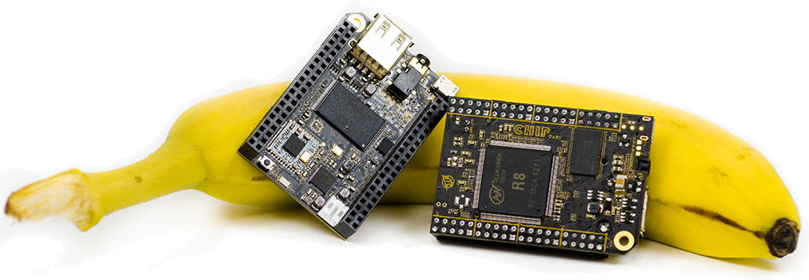
SBC ~ C.H.I.P. Crowd-funded
USD $9
Estimated public shipping - June 2016

Slide 15
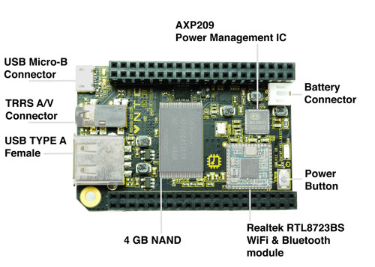
SBC ~ C.H.I.P.

Slide 16
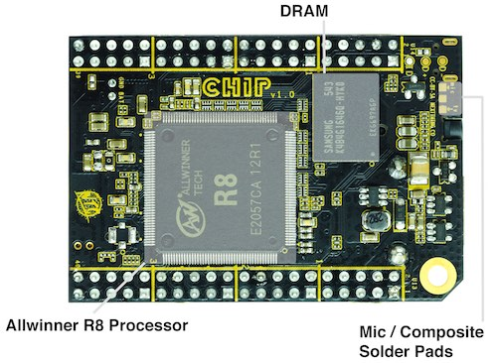
SBC ~ C.H.I.P.

Slide 17
SBC ~ C.H.I.P.
Wireless
WiFi CHIP supports 802.11b/g/n using the built-in WiFi.
Bluetooth
CHIP supports the Bluetooth 4.0 LE standard using the built-in Bluetooth.
Physical Connectors
CHIP is loaded with essential connectors for USB, serial, audio, video, and loads of IO on the pin headers.
Button
A tiny tiny button on CHIP next to pin header U13 that is used for turning CHIP on or off.
USB
The single USB port on CHIP is USB 2.0 compatible. It can provide up to 500mA of current, as is standard for USB ports on computers. If you need to provide more current, we recommend a powered USB hub.
Composite Video and Stereo Audio
The 1/8" TRRS connector provides composite video and stereo audio output. Headphones can be plugged in for audio only.

Slide 18
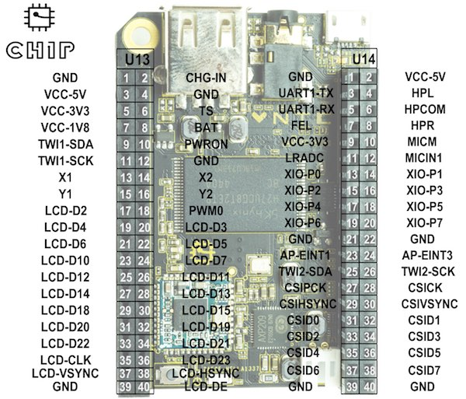
SBC ~ C.H.I.P.

Slide 19
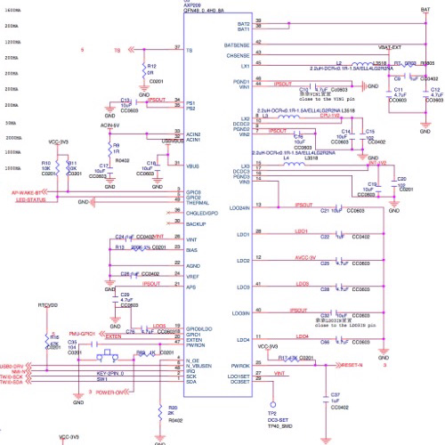
SBC ~ C.H.I.P. Open Source Hardware

Slide 20

Raspberry Pi

Slide 21
Who' s who in making a Raspberry Pi
ARM Holdings plc (ARM) Semiconductor and software design company. Cambridge, England. CPU architectures:
  ARM1176JZF-S. Single core. Pi1 Model A, B, A+, B+. Pi0.
  ARM Cortex-A7 MPCore. Quad-core. Pi2 Model B.
Broadcom Corporation. Fabless semiconductor company. Incorporate ARM technology in designs. Add VideoCore IV GPU, Digital Signal Processor (DSP), etc. SoC's:
  BCM2835 Pi1 Model A, B, A+, B+ 700MHz. Pi0 1GHz.
  BCM2836C Pi2 Model B 900MHz Quad core.
Samsung, Hynix etc. Fabricators of Broadcom designed chips.
Raspberry Pi Foundation. UK Charity founded in 2009. Responsible for developing the Raspberry Pi. Engineering and trading activities Raspberry Pi (Trading) Ltd.
Egoman, Sony, Qisda - RPi Board manufacturers.

Slide 22
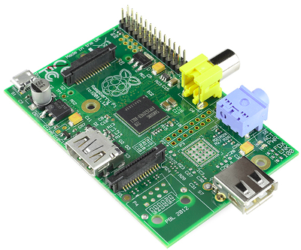
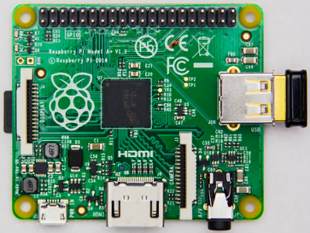
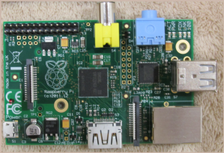
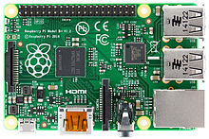
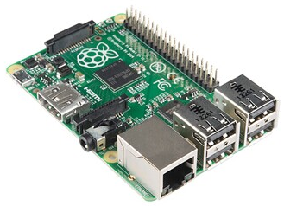
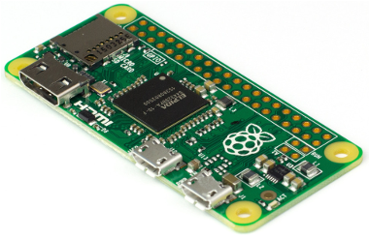
Overview of Raspberry Pi Hardware
Models of Raspberry Pi's (as of Dec 2015).
R-Pi 1 Model A
R-Pi 1 Model B
R-Pi 1 Model A+
BCM2835 – 700MHz 256-512MB
BCM2835 – 700MHz 256~512MB
BCM2835 – 700MHz 512MB
R-Pi 1 Model B+
R-Pi 2 Model B
R-Pi Zero
BCM2835 – 700MHz 512MB
BCM2836C – 900MHz 1GB
BCM2835 – 1GHz 512MB

Slide 23
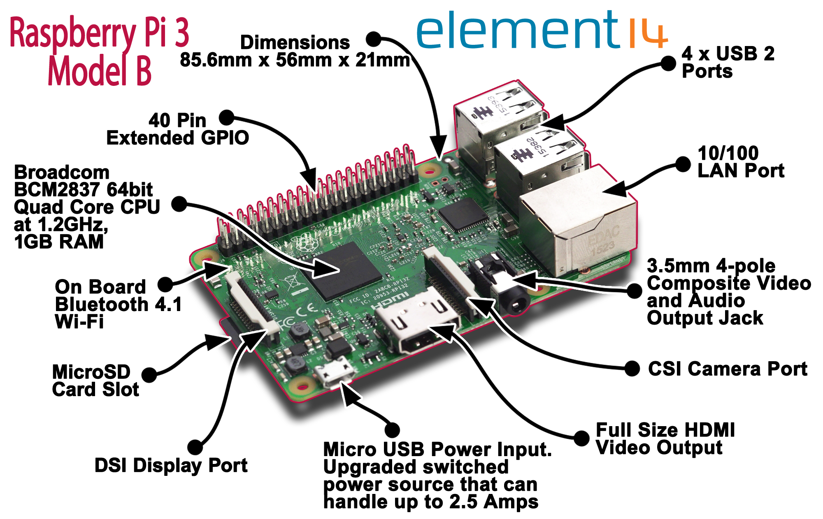
Overview of Raspberry Pi Hardware

Slide 24
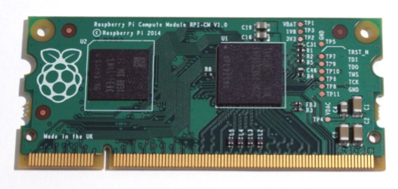
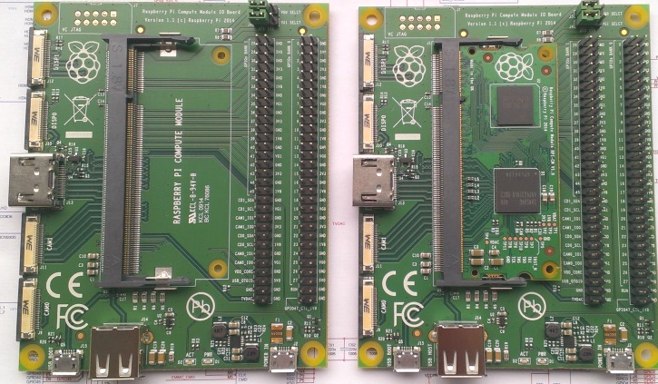
Overview of Raspberry Pi Hardware
standard DDR2 SODIMM connector
full flexibility of the BCM2835 SoC
many more GPIOs and interfaces are available as compared to the Raspberry Pi
4Gbyte eMMC Flash device
R-Pi Computer
BCM2835 – 700MHz 512MB
BCM2835 – 700MHz 512MB
BCM2835 – 700MHz 512MB
BCM2835 – 700MHz 512MB

Slide 25
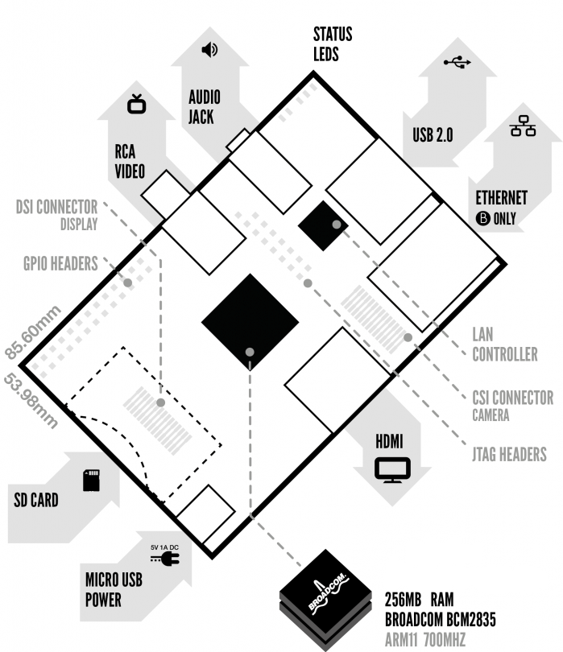
Overview of Raspberry Pi Hardware
Models: A & B.
Connectors:
GPIO Headers
SD-Card
Power – Micro-USB
DSI Display
HDMI
USB 2.0
CSI Camera
RCA Video
Audio
JTAG Headers
LAN

Slide 26
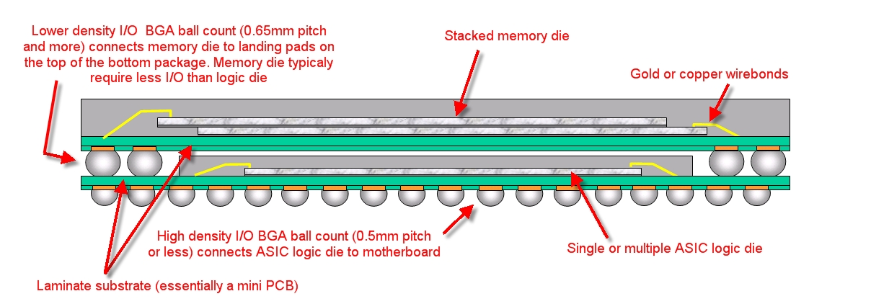
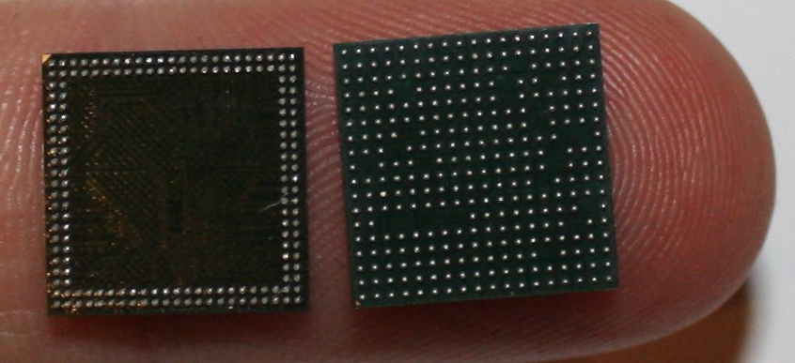
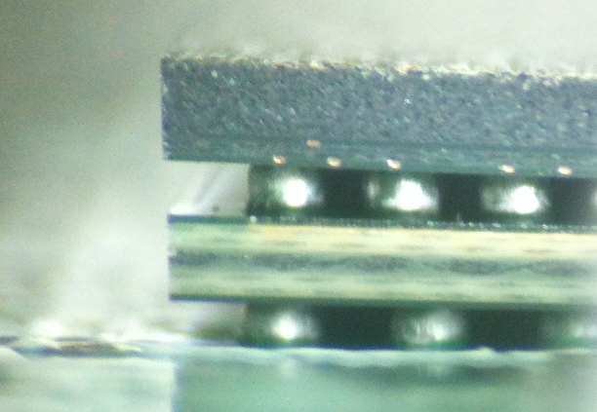
Overview of Raspberry Pi Hardware
Broadcom 2835 Package on Package. System on a chip SoC.
"ASIC + Memory PoP Schematic" by Moody751 at English Wikipedia. Licensed under CC BY 3.0 via Commons
https://commons.wikimedia.org/wiki/File:ASIC_%2B_Memory_PoP_Schematic.JPG#/media/File:ASIC_%2B_Memory_PoP_Schematic.JPG
https://www.raspberrypi.org/wp-content/uploads/2012/01/brcm2835plusmemory.jpg

Slide 27
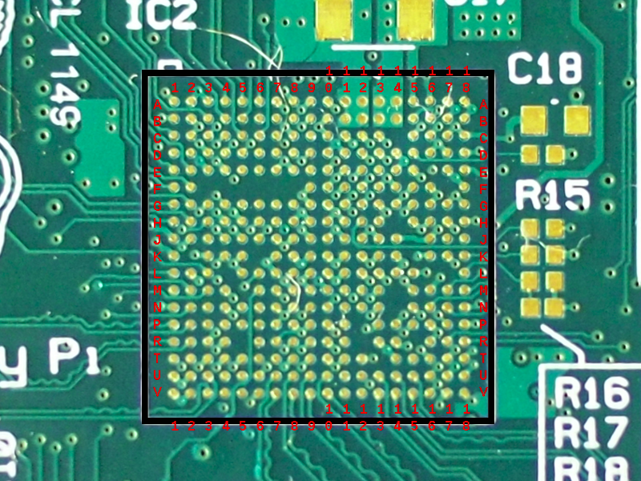
Overview of Raspberry Pi Hardware
Broadcom 2835 Pins. http://elinux.org/File:RPi_BCM2835_pinout_front.png

Slide 28
Overview of Raspberry Pi Hardware
Broadcom 2835 chip. 18 x 18 matrix = 324 pins
Pins Count | Pins Used | Pin Purpose
324 | 25 | No pin at this position protruding from chip
299 | 50 | Pin is not connected to board signal
249 | 87 | Grounded pins
162 | 15 | 1.8V
147 | 1 | 2.5V
146 | 11 | 3.3V
135 | 5 | 5.0V
130 | 2 | HDMI_1V8 & 3V3
128 | 3 | PLL_VDD
125 | 5 | SDC_VDD
120 | 10 | SDRAM_VDD
110 | 15 | VDD_CORE
95 | 14 | VDD_IO
81 | 4 | VDD_OUT
77 | 2 | VDD3_L
75
Summary
25 No pin
50 N/C
87 Ground
32 Supplying voltages.
55 Signals tied to a voltage rail
Data Signals

Slide 29
Overview of Raspberry Pi Hardware
Pins Count | Pins Used | Pin Naming | Purpose
75 | 8 | CAM or CAM1 | Camera signals to CSI connector
67 | 1 | COMPVID | Composite video to RCA socket
66 | 6 | DSI1 | Display Serial Interface to DSI connector
60 | 12 | GPIO_GEN1 | General Purpose Input / Output signals. 1 General Clock.
48 | 13 | HDMI | High-Definition Multimedia Interface to HDMI connector
35 | 1 | LAN_RUN | Local Area Network
34 | 2 | PWM0 & 1_OUT | Pulse Width Modulation
32 | 1 | RUN | Run. Used to reset the system
31 | 2 | RXD0 & TXD0 | Universal Asynchronous Receiver Transmitter UART.
29 | 2 | SCL0 & 1 | I²C Serial Bus. Serial Clock Line (SCL)
27 | 7 | SD_Card | Secure Digital card (SD card)
20 | 2 | SDA 0 & 1 | I²C Serial Bus. Serial Data Line (SDA)
18 | 5 | SPI_ | Serial Peripheral Interface (SPI). Synchronous
13 | 1 | STATUS_LED_N | LED status or GPIO16
12 | 3 | USB_ | Universal Serial Bus
9 | 5 | VC_ | Video Codec
4 | 1 | VID_DAC | Video digital-to-analog converter (DAC)
3 | 2 | XN & XP | Crystal Oscillator
1 | 1 | ZQ | ?

Slide 30
Overview of Raspberry Pi Hardware
50 x pins with no connection to the mother board
Pin Count | Pins Used | Pin Naming | Purpose
50 | 10 | CAM 0 & 1 | Camera
40 | 4 | CCP2
36 | 10 | DSI 0 & 1 | Display Serial Interface to DSI connector
26 | 17 | GPIO | General Purpose Input Output
9 | 1 | HAT | Hardware Attached on Top
8 | 4 | NVM | Non Volatile Memory
4 | 2 | SLIM
2 | 2 | USB | Universal Serial Bus
0
Pins Count | Pins Used | Pin Naming | Purpose
75 | 8 | CAM or CAM1 | Camera signals to CSI connector
67 | 1 | COMPVID | Composite video to RCA socket
66 | 6 | DSI1 | Display Serial Interface to DSI connector
60 | 12 | GPIO_GEN1 | General Purpose Input / Output signals. 1 General Clock.
48 | 13 | HDMI | High-Definition Multimedia Interface to HDMI connector
35 | 1 | LAN_RUN | Local Area Network
34 | 2 | PWM0 & 1_OUT | Pulse Width Modulation
32 | 1 | RUN | Run. Used to reset the system
31 | 2 | RXD0 & TXD0 | Universal Asynchronous Receiver Transmitter UART.
29 | 2 | SCL0 & 1 | I²C Serial Bus. Serial Clock Line (SCL)
27 | 7 | SD_Card | Secure Digital card (SD card)
20 | 2 | SDA 0 & 1 | I²C Serial Bus. Serial Data Line (SDA)
18 | 5 | SPI_ | Serial Peripheral Interface (SPI). Synchronous
13 | 1 | STATUS_LED_N
12 | 3 | USB_ | Universal Serial Bus
9 | 5 | VC_ | Video Codec
4 | 1 | VID_DAC | Video digital-to-analog converter (DAC)
3 | 2 | XN & XP
1 | 1 | ZQ
Previous 3 slides information is “unofficial”.
Accredited to AndrewS
http://elinux.org/RPi_schematics_breakdown
http://elinux.org/RPi_BCM2835_Pinout
http://elinux.org/RPi_BCM2835_Signals_Rev2.0

Slide 31
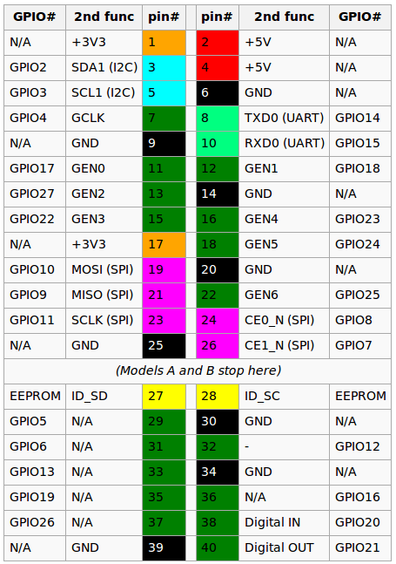
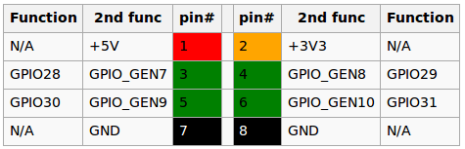
Overview of Raspberry Pi Hardware
GPIO Connector
RPi A and B have only the first 26 pins.
RPi A+, B+, 2B 40 pins.
RPi Zero GPIO J8 40-pin pinout.
Model B rev 2 also has a pad (called P5 on the board and P6 on the schematics) of 8 pins offering access to an additional 4 GPIO connections.
Signal referencing by Python:
BOARD Pin numbers on the connector.
BCM Broadcom signal naming.

Slide 32
Raspian Installation
Installation documentation for Linux system installation…
https://www.raspberrypi.org/documentation/installation/installing-images/linux.md
Latest Raspbian. Debian 8 Code name: Jessie
Release date: 2016-03-18 Kernel version: 4.1
Install steps:
Download 1.4GB .zip file using torrent
Extract from zip file to get 3.9GB .img file.
Insert a 4GB (minimum) SD-Card into PC.
Get the device name. $ df -h E.g. /dev/mmcblk0p2
$ umount /dev/mmcblk0p2 and other partitions p1 p5, etc.
$ sudo dd bs=4M if=2016-03-18-raspbian-jessie.img of=/dev/mmcblk0
$ sync
Remove SD-Card. Insert in Raspberry Pi and boot.
Exit from X windowing system.
$ rasp-config to...
Expand file system to fill the SD-Card.

Slide 33
Rpi.GPIO
Rpi.GPIO - A Python module to control the General Purpose Input's and Output's (GPIO) on a Raspberry Pi.
Although it is included with 2016-03-18 release of Raspian, Rpi.GPIO can be downloaded from…
http://sourceforge.net/projects/raspberry-gpio-python/files/raspbian-jessie/
Download both python 2 and 3 .deb files and install.
Rpi.GPIO is at revision 0.6.0a3 (as of DEC 2015)
Ben Croston main author / maintainer.
Supports Input, Output and Pulse Width Modulation (PWM).
Does not support SPI, I2C, 1-wire or serial functionality on the RPi yet. This is planned for the future.
https://github.com/cymplecy/sca/blob/master/sgh_GPIOController.py

Slide 34
Other standard features of Raspian distro
Python 2 and python3
Idle. Integrated Development and Learning Environment for python 2 and 3.
Repository for download additional applications. Use apt-get or GUI installer.
http://archive.raspbian.org/raspbian/pool/
App store
Of the other applications packaged with the Raspian distro they appear to be chosen based on requiring minimal memory, so functionality is often lacking.

Slide 35
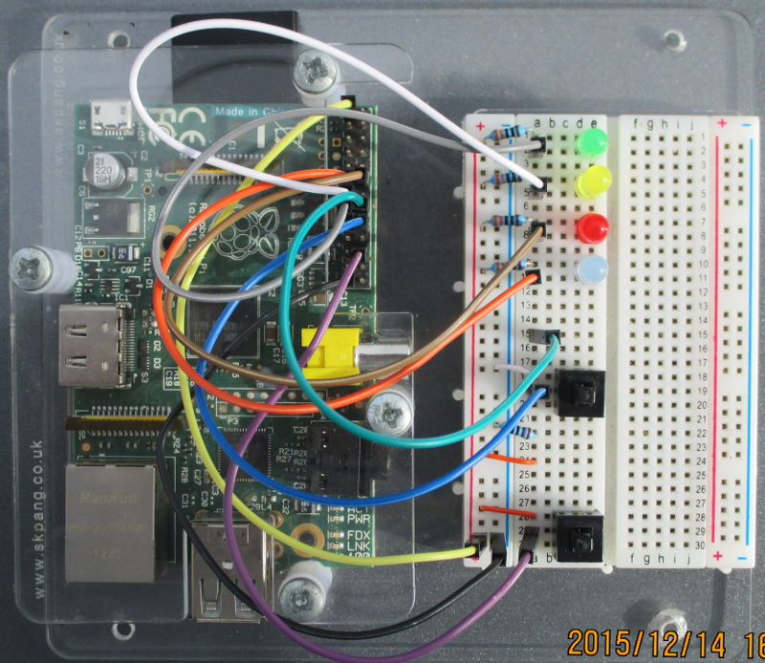
Raspberry Pi1 Model B and breadboard

Slide 36
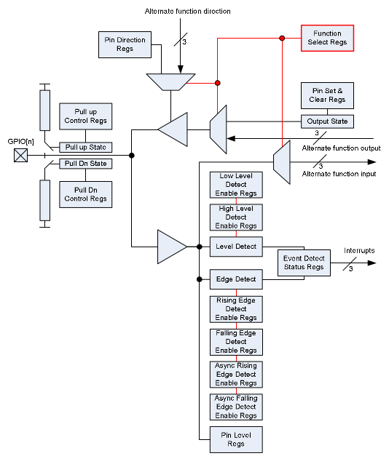
GPIO pin block diagram

Slide 37
Example: GPIO pin Function select
FSEL9 - Function Select 9
000 = GPIO Pin 9 is an input
001 = GPIO Pin 9 is an output
100 = GPIO Pin 9 takes alternate function 0
101 = GPIO Pin 9 takes alternate function 1
110 = GPIO Pin 9 takes alternate function 2
111 = GPIO Pin 9 takes alternate function 3
011 = GPIO Pin 9 takes alternate function 4
010 = GPIO Pin 9 takes alternate function 5

Slide 38
Rpi.GPIO code IO signal/pin as Output
lsusb
import RPi.GPIO as gpio
gpio.setmode(gpio.BOARD) # or BCM
gpio.setup(12, gpio.OUT) # 12 = P1 Connector Pin 12 = BCM 17
gpio.output(12, False) # Signal goes to Ground. LED on
gpio.output(12, True) # Signal goes to +3.3V. LED off
gpio.cleanup()

Slide 39
Rpi.GPIO code IO signal/pin as Input
lsusb
import RPi.GPIO as gpio
from time import sleep
import sys
def switch_callback(channel):
if gpio.input(channel):
print('Input High')
else:
print('Input LOW')
gpio.setmode(gpio.BOARD) # or BCM
gpio.setup(12, gpio.IN, pull_up_down=gpio.PUD_DOWN)
gpio.add_event_detect(12, gpio.RISING, callback=switch_callback)
sleep(10)
# ← Press a switch to toggle the signal on the input.
sys.exit()
# Note: Run using sudo to prevent error with Revision 0.6.0.a3

Slide 40
Rpi.GPIO code IO signal/pin as Pulse Width Modulation (PWM)
lsusb
import RPi.GPIO as gpio
from time import sleep
import sys
gpio.setmode(gpio.BOARD) # or BCM
gpio.setup(12, gpio.OUT)
# Instantiate pwm_channel
pwm_channel = gpio.PWM(12, 1) # Pin 12 at frequency of 1Hz
pwm_channel.start(5) # Start with 1Hz and duty cycle of 5%
pwm_channel.ChangeDutyCycle(50) # 50 percent
pwm_channel.ChangeFrequency(10) # 10Hz
sleep(10)
sys.exit()

Slide 41
Single Board Computers
__end__

